Slide 1
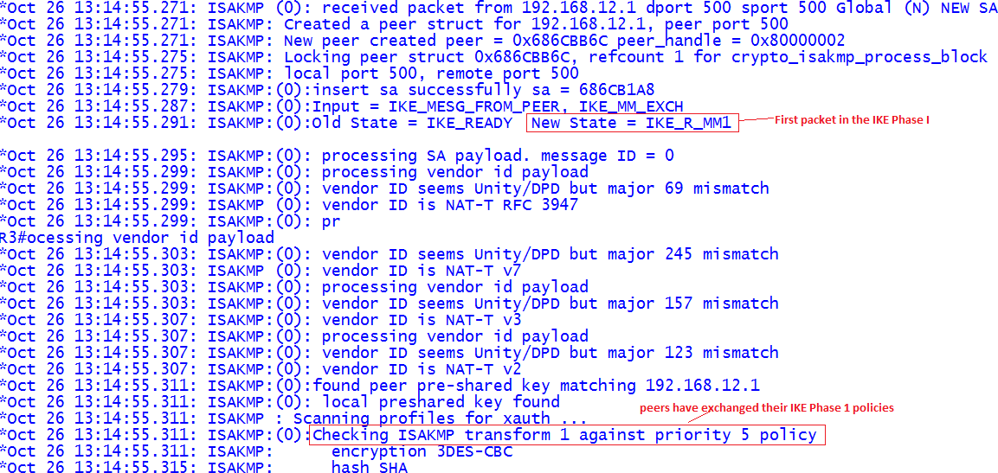
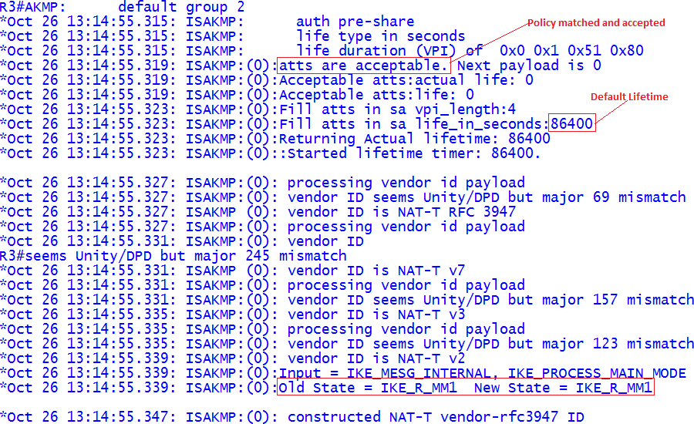
Site-to-Site IPSec VPN Troubleshoot:
Troubleshooting VPN using debug commands. Start with the debug crypto isakmp command and walk through a successful ISAKMP SA creation. After issue, the clear crypto session command and ping a host from one side to the other side.
R3# Debug crypto isakmp

Slide 2
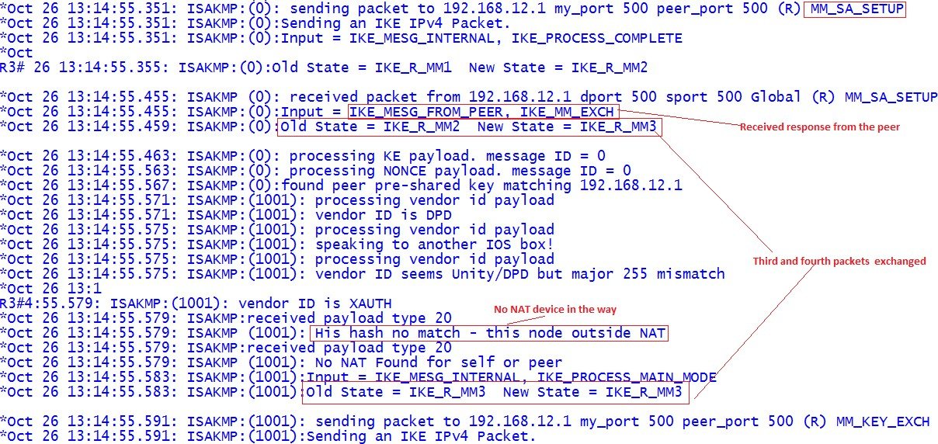
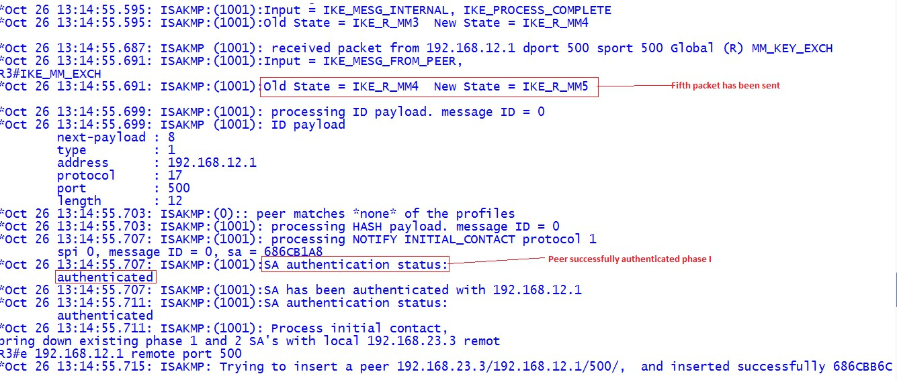

Slide 3
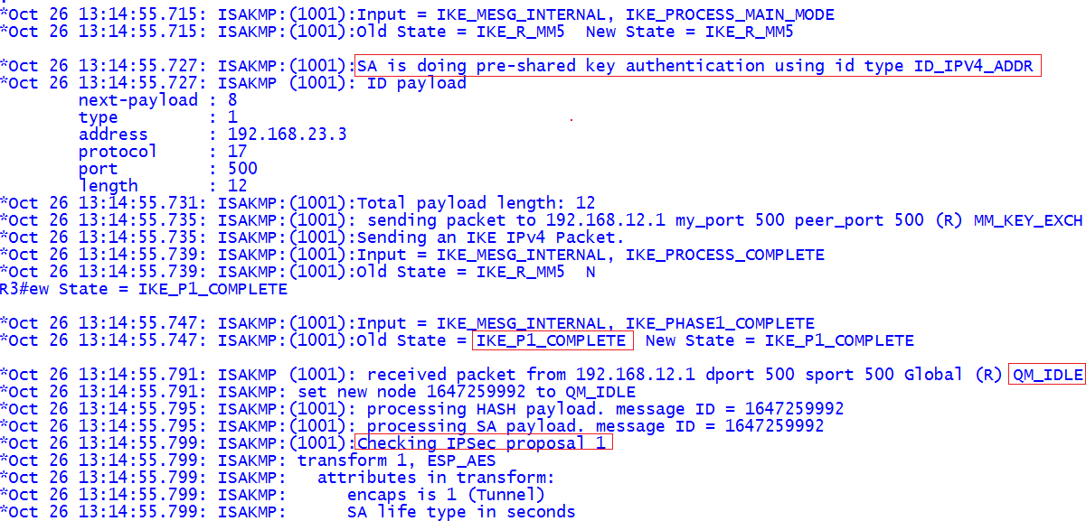
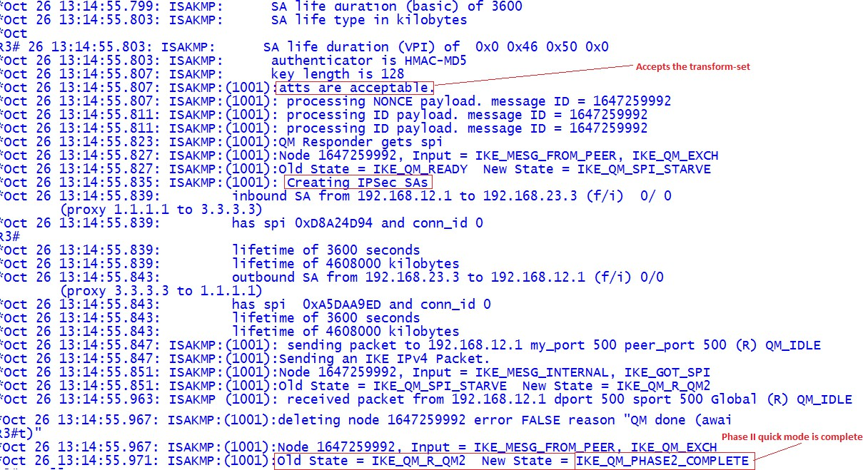
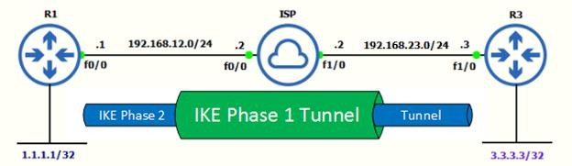

Slide 4
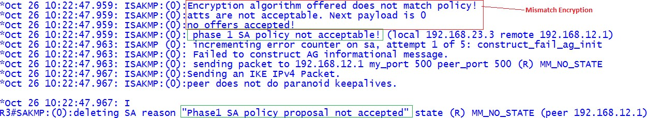
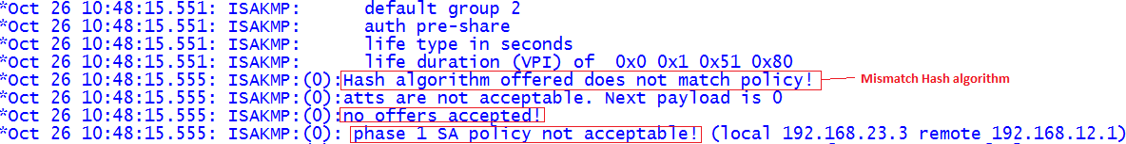
Troubleshooting Phase 1:
Let us Make some changes to the ISAKMP policy on the remote peer and clear the crypto session by issuing the clear crypto session command. When do the debug after we clear the session, the changes I made should be reflected.
Mismatch Encryption in the ISAKMP Policy:
R3(config)#crypto isakmp policy 5
R3(config-isakmp)#authentication pre-share
R3(config-isakmp)#encryption aes
R3(config-isakmp)#group 2
R3(config-isakmp)#hash sha
R3(config-isakmp)#lifetime 86400
R3(config-isakmp)#exit
R3(config)#crypto isakmp key cisco123 address 192.168.23.3
R3# debug crypto isakmp
Mismatch Hash Algorithm in the ISAKMP Policy:
R3(config)#crypto isakmp policy 5
R3(config-isakmp)#authentication pre-share
R3(config-isakmp)#encryption 3des
R3(config-isakmp)#group 2
R3(config-isakmp)#hash md5
R3(config-isakmp)#lifetime 86400
R3(config-isakmp)#exit
R3(config)#crypto isakmp key cisco123 address 192.168.23.3
R3# debug crypto isakmp

Slide 5
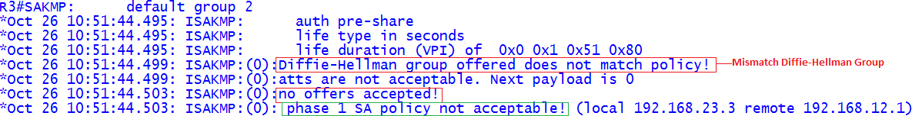
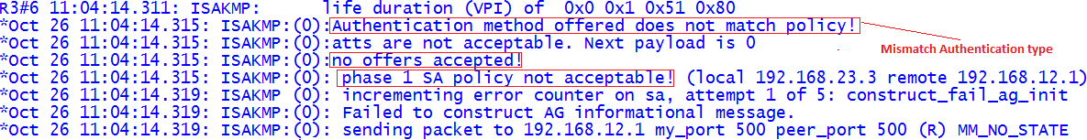
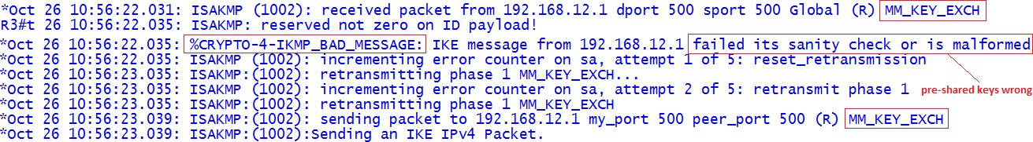
Mismatch Diffie-Hellman Group in ISAKMP Policy:
R3(config)#crypto isakmp policy 5
R3(config-isakmp)#authentication pre-share
R3(config-isakmp)#encryption 3des
R3(config-isakmp)#group 5
R3(config-isakmp)#hash sha
R3(config-isakmp)#lifetime 86400
R3(config)#crypto isakmp key cisco123 address 192.168.23.3
R3# debug crypto isakmp
Mismatch Authentication Type in ISAKMP Policy:
R3(config)#crypto isakmp policy 5
R3(config-isakmp)# authentication rsa-sig
R3(config-isakmp)#encryption 3des
R3(config-isakmp)#group 2
R3(config-isakmp)#hash sha
R3(config-isakmp)#lifetime 86400
R3(config)#crypto isakmp key cisco123 address 192.168.23.3
R3# debug crypto isakmp
Pre-Shared Keys are wrong:
R3(config)#crypto isakmp key cisco12 address 192.168.23.3
R3# debug crypto isakmp

Slide 6
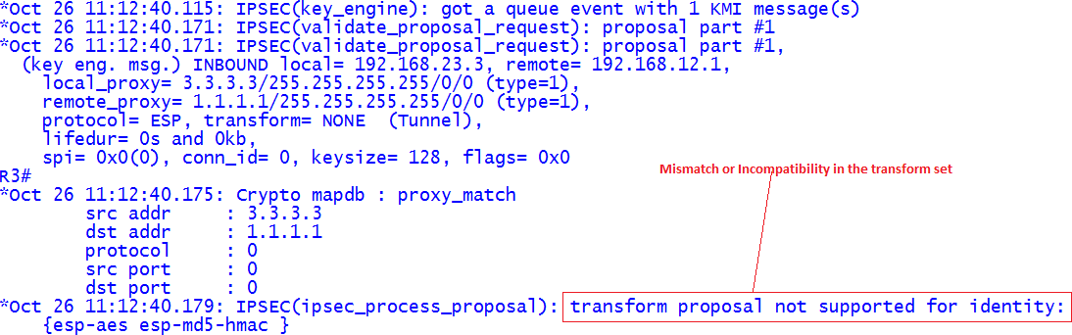
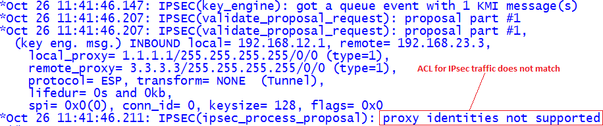
Troubleshooting Phase 2:
Let us jump into Phase 2 troubleshooting. Going to alter IPSec, transform set to let it fail on Phase 2. By changing the transform set, Main Mode exchange complete and Phase 2 start.
I changed the responder transform-set to esp-3des instead of esp-aes like the one the peer is configured to this router and I am using debug crypto ipsec to generate the following output.
Mismatch Transform-Set Attribute:
R1(config)# crypto ipsec transform-set TSET esp-3des esp-md5-hmac
R1(cfg-crypto-trans)#crypto ipsec security-association lifetime seconds 3600
R3#debug crypto ipsec
Wrong ACL in the Crypto Map:
Now let us put the wrong ACL in the crypto map or do not put the one that matches traffic for the traffic going from one side to the other. On the responder, it will clearly state that the proxy IDs are what were not supported:
R1(config)#crypto map CMAP 10 ipsec-isakmp
R1(config-crypto-map)#match address VPN
R1(config-crypto-map)#set peer 192.168.23.3
R1(config-crypto-map)#set transform-set TSET
R3#debug crypto ipsec

Slide 7
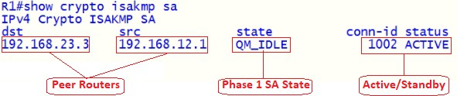
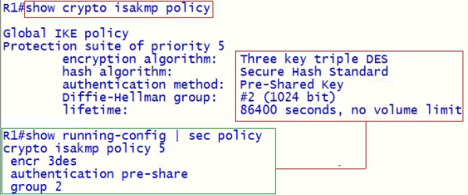
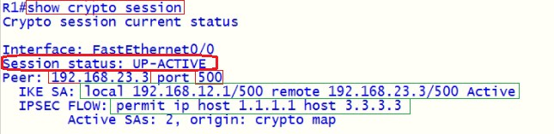
Show Commands to Troubleshooting VPN:
This command shows the Internet Security Association Management Protocol (ISAKMP) security associations (SAs) built between peers. This command displays the details for the IKE Phase 1 tunnel including the current status.
This command, displays the encryption algorithm, hash algorithm, authentication method, and Diffie-Hellman group configured on the device.
This command will give a quick list of all IKE and IPSec SA sessions. Using the commands can easily verify whether an IPSec tunnel is active, down, or still negotiating.

Slide 8
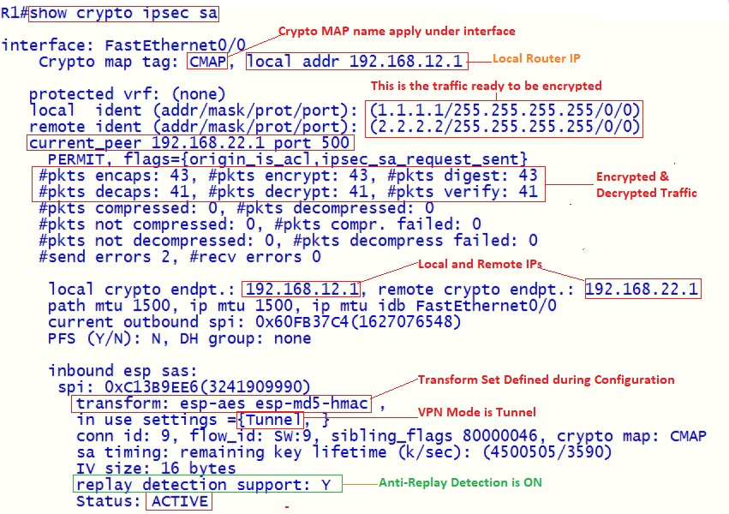
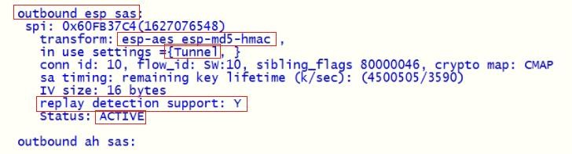
This command shows IPsec SAs built between peers. The encrypted tunnel is built between peers for traffic that goes between. Two ESP SAs built inbound and outbound. This command displays the details for the IKE Phase 2 tunnel.
This command verify and display Phase 1 Preshared Key.

Slide 9
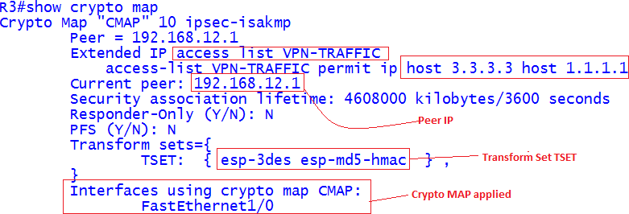

This command displays the details of a crypto map, where it is applied, transform set, ACLs involved, and who the peer address and security association lifetime details.
This command verify and check crypto ACLs for hit counts.
Verify for mirrored crypto ACLs on each side.

